Slide 1
Visualization test
additional visualizations created
GAMMA interview

Slide 2
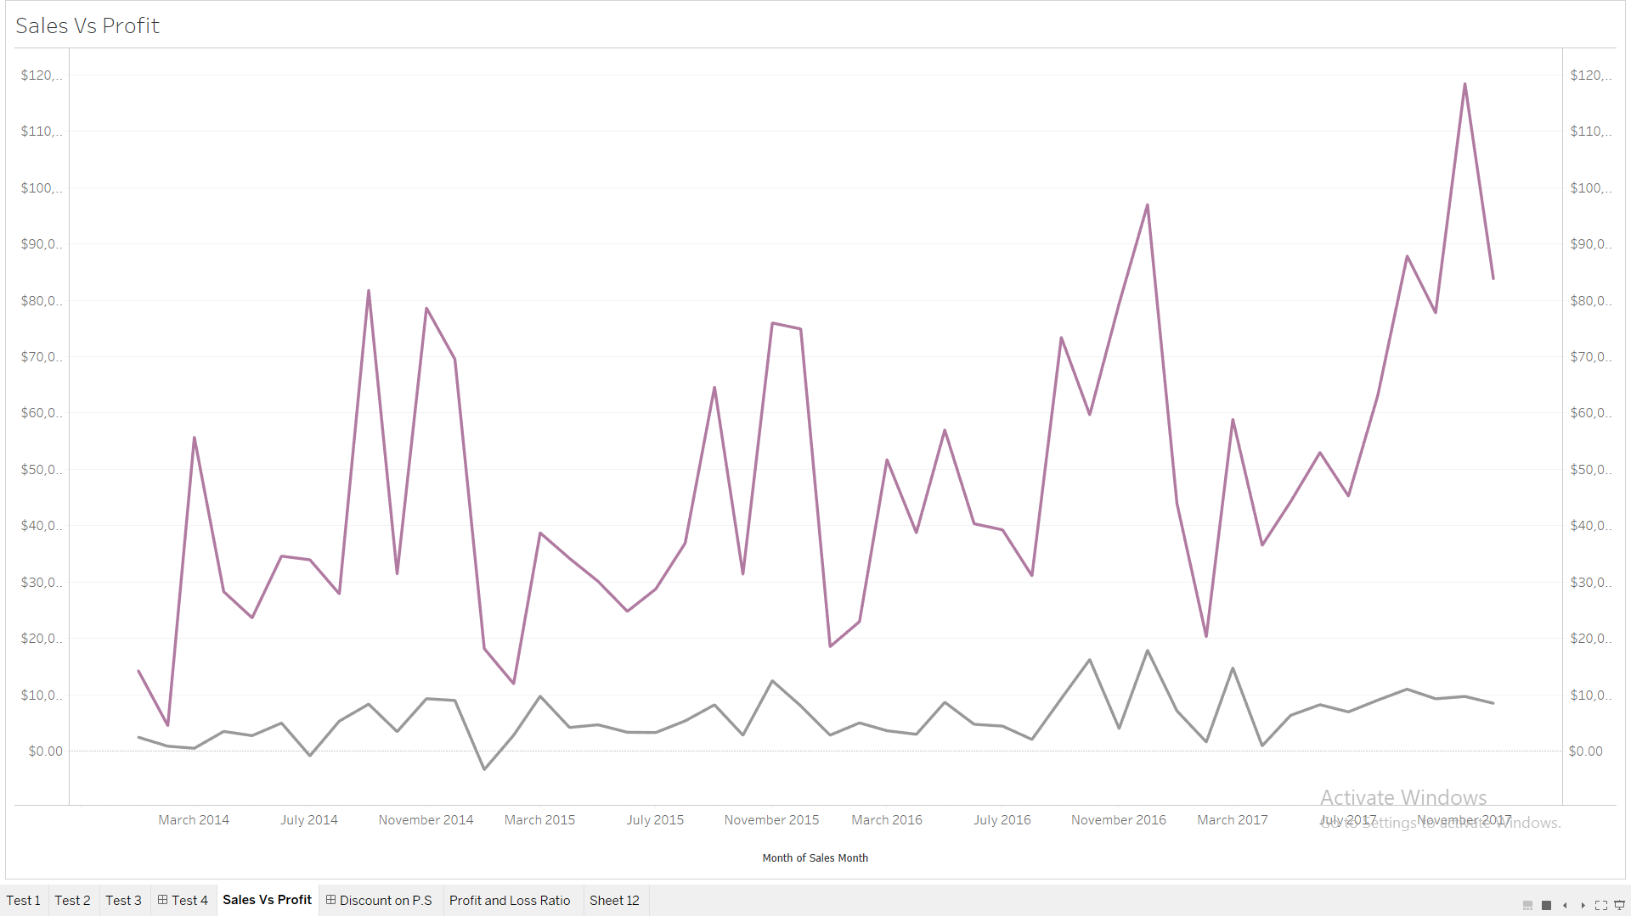
Sales Vs Profit
This view which shows 2 lines, 1 for sales and 1 for profit on the same scale
Sales show seasonality over the period and an overall upward trend
The profit line shows a study fluctuation over the period
Data: Sales.xls
Notes:
Check on basic tableau

Slide 3
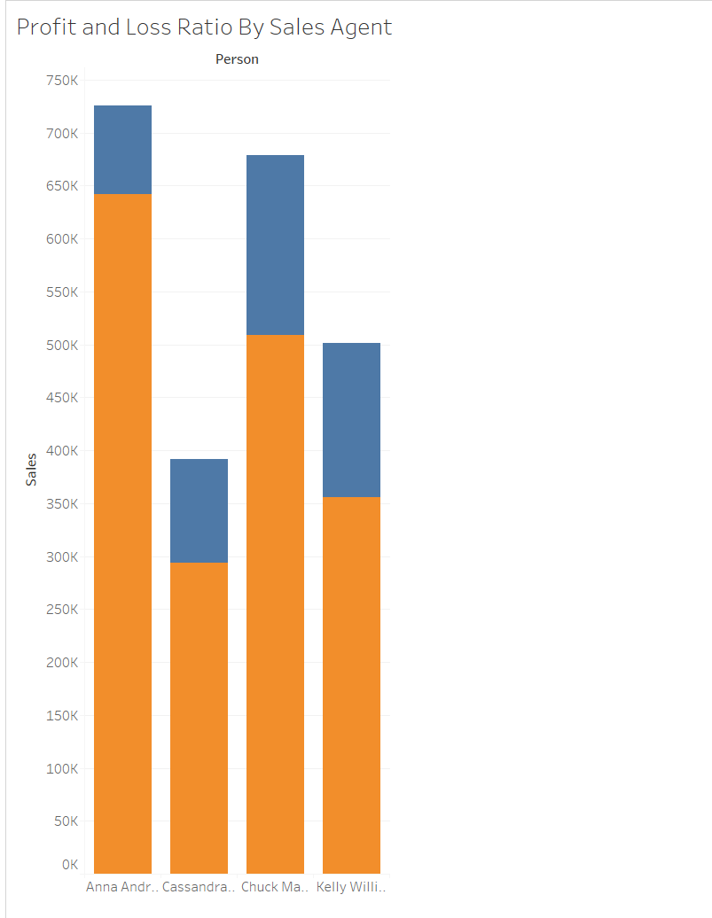
Profit/Loss Ratio by Sales Person
This view shows the 4 sales persons against the total profit or loss amount made on sales.
With colors,
Orange – Profit ,Blue - Loss
Move cursor over color to highlight
1.Profit or Loss
2.Person
3.Sales
4. Profit Ratio
Profit or Loss and Profit ratio fields are calculated
Data: Sales.xls
Notes:
Check on basic tableau

Slide 4
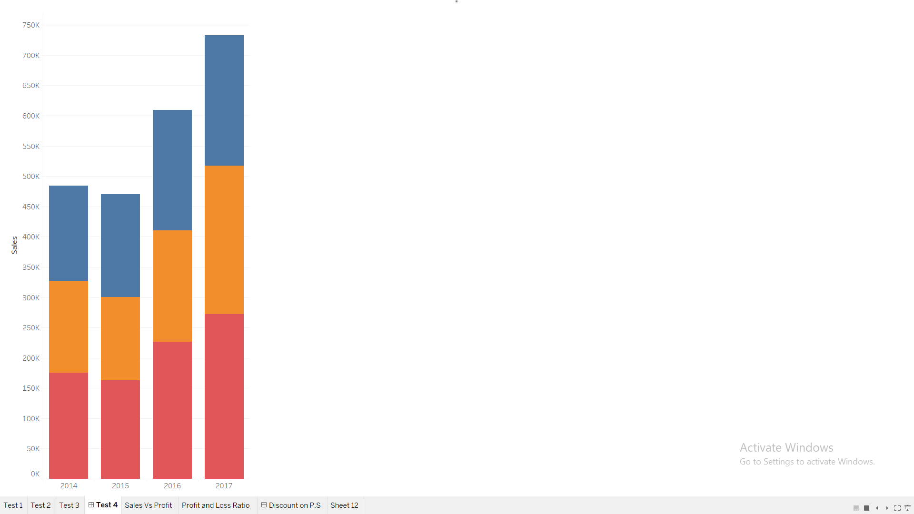
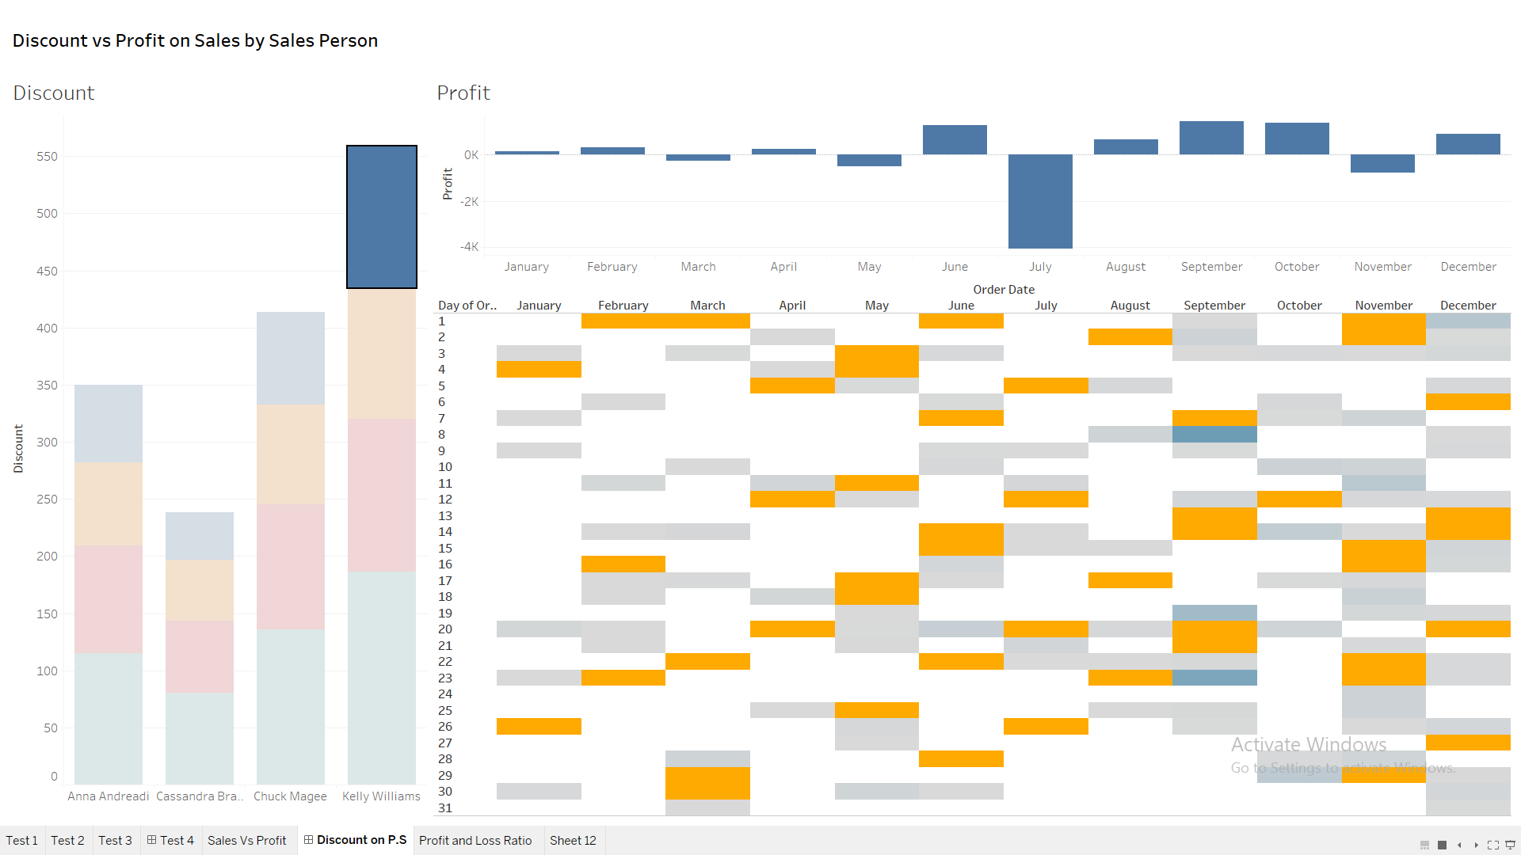
Discount on Sales by Sales Person and how it affects Profit
This view shows discounts by sales person and year on a dashboard.
When clicked on the bar chart, profit data by year for that sales person appears in the second chart
In the month by day chart, weekends appear as orange and weekdays have discount in gradient color according to discounts value (lighter to darker blue)
Data: Sales.xls

